Slide 1
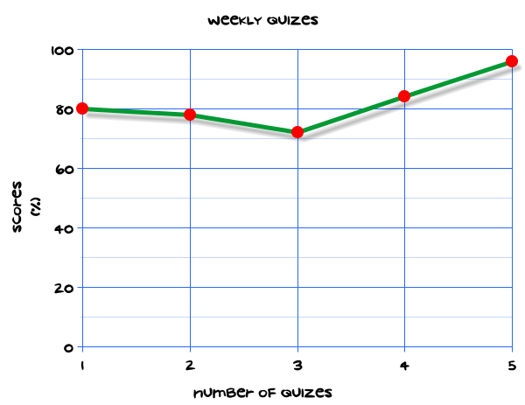
My Statistics Interactive Notebook
Name
Class
Teacher
Term 1 Semester 1
1

Slide 2
Contents
Glossary or Formula Page
Page
Date
Description
2
3

Slide 3
Tasks
24
7
30
Essential Question
Questions
Notes
Summary
4
5

Slide 4
24
7
30
Date
Stem and leaf plots
EQ – Describe how to find averages from a stem and leaf plot.
How do I create a stem and leaf plot?
stem and leaf plot – mymaths lesson link
Notes:
plo

Slide 5
24
7
30
Date
Stem and leaf plots
EQ – Describe how to find averages from a stem and leaf plot.
How do I create a stem and leaf plot?
stem and leaf plot
How do I use the plot to find the mode, median and range?
Notes:
plo

Slide 6
24
7
30
Date
Stem and leaf plots
EQ – Describe how to find averages from a stem and leaf plot.
How do I create a stem and leaf plot?
stem and leaf plot
How do I use the plot to find the mode, median and range?
What is symmetrical and skewed data?
Notes:
plo

Slide 7
Task
Page 542/543 – questions 1 and 3

Slide 8
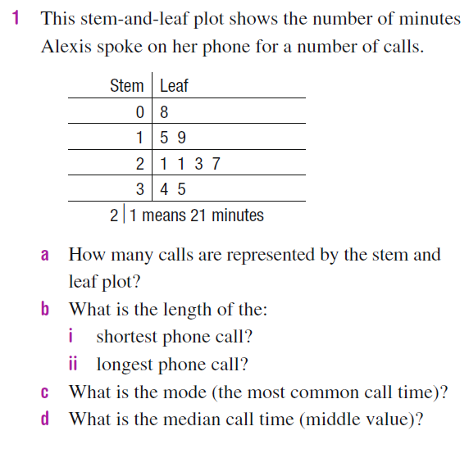

Slide 9
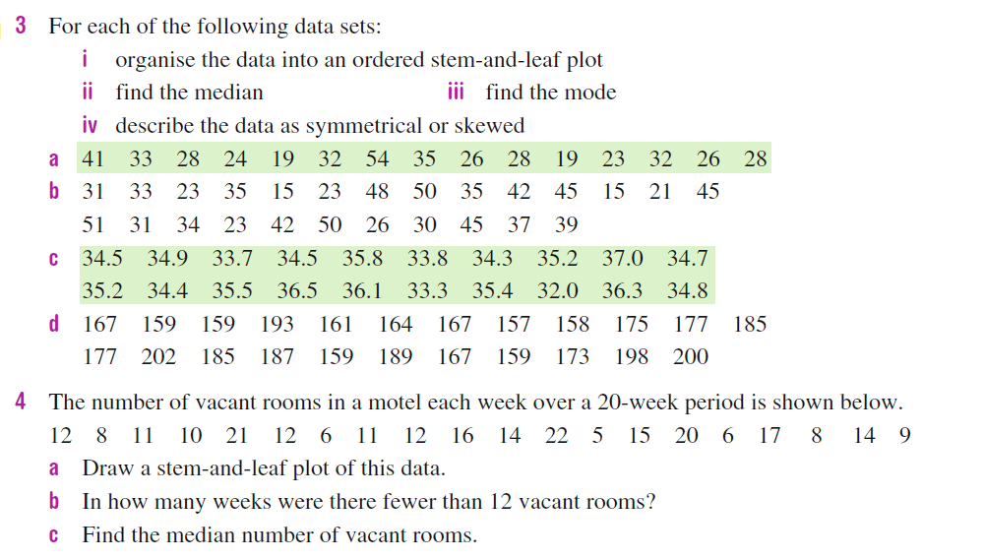

Slide 10
Notes Review
24, 7 ,30
Date
Title
Essential question
Notes complete
Notes complete with colour and diagrams
Questions completed
Contents page filled in
Formula page filled in

Slide 11
Homework
Review your notes and write a summary answering the essential question.

